Slide 1

Learn & Translate
Easy and fun

Slide 2


Translate
PLAY
Get feedback

Slide 3



FEATURES

Slide 4
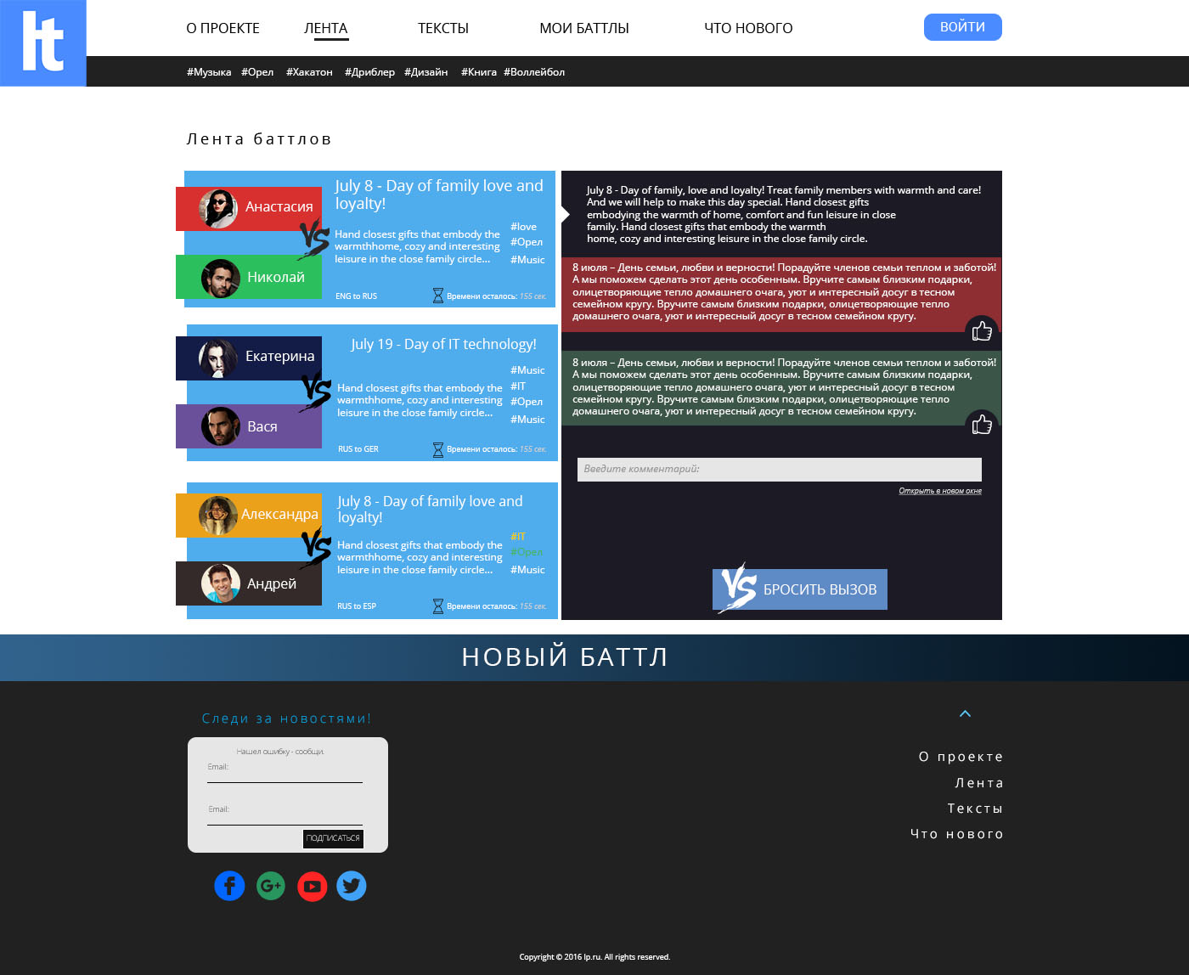

Slide 5
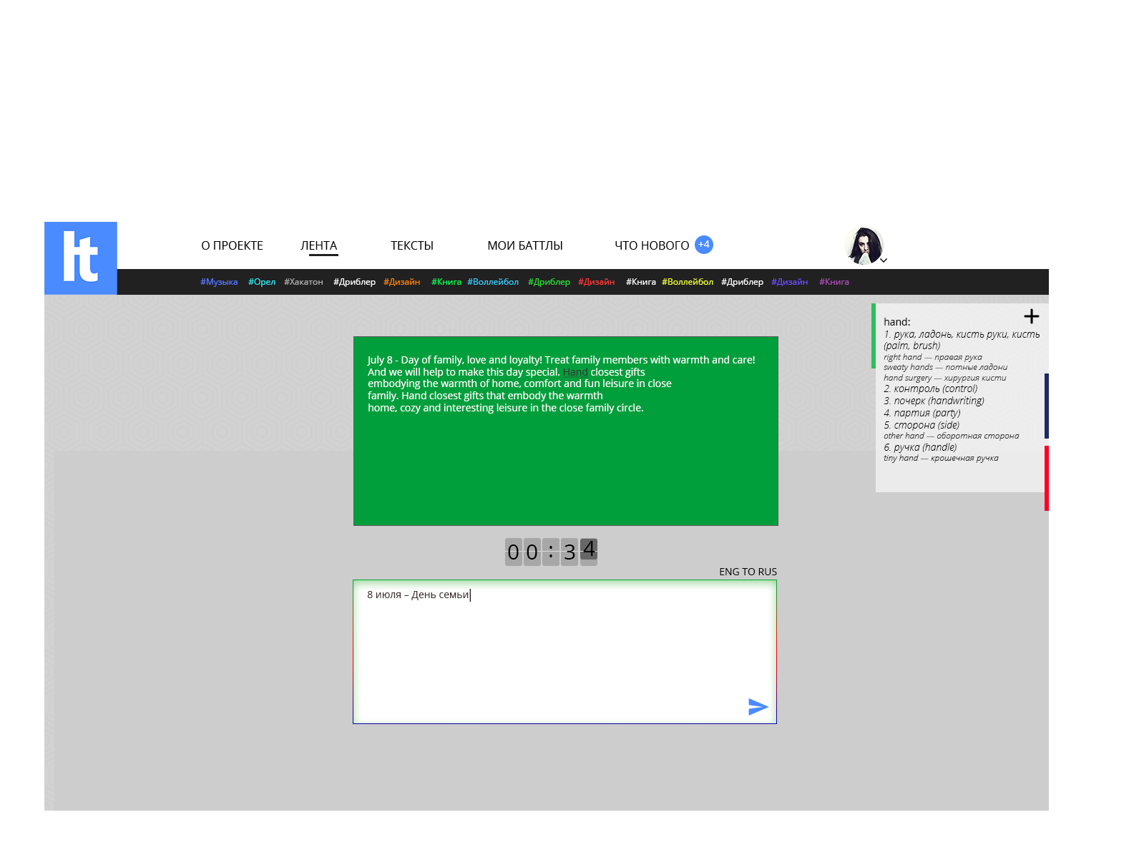

Slide 6
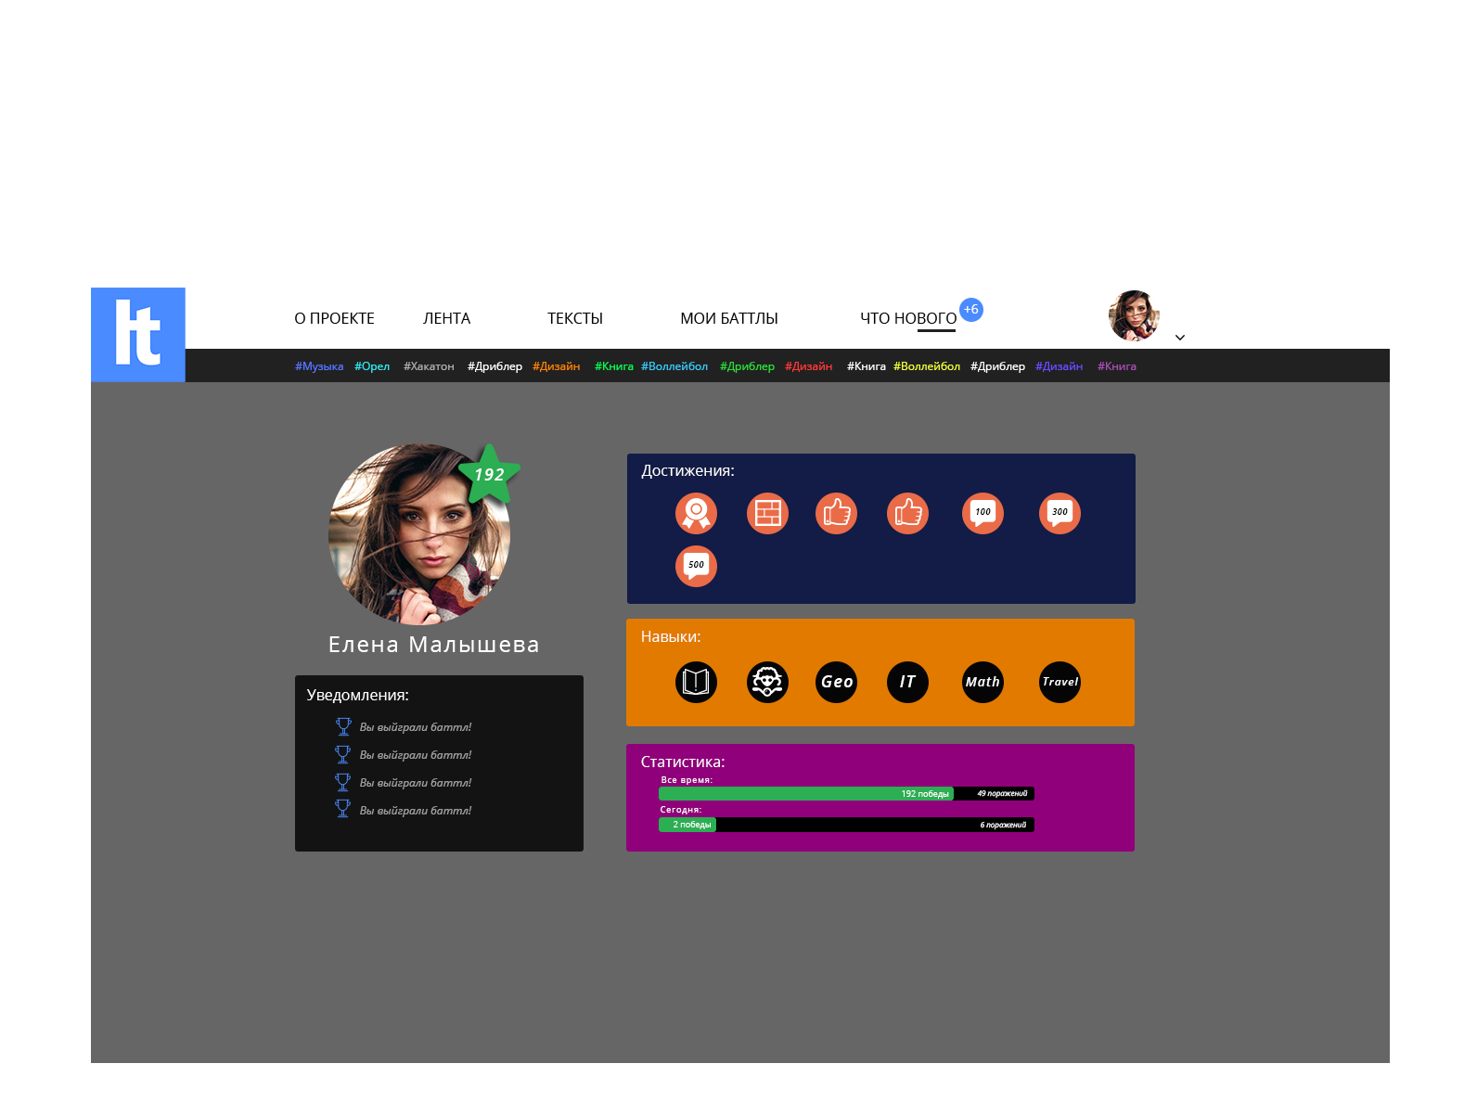

Slide 7
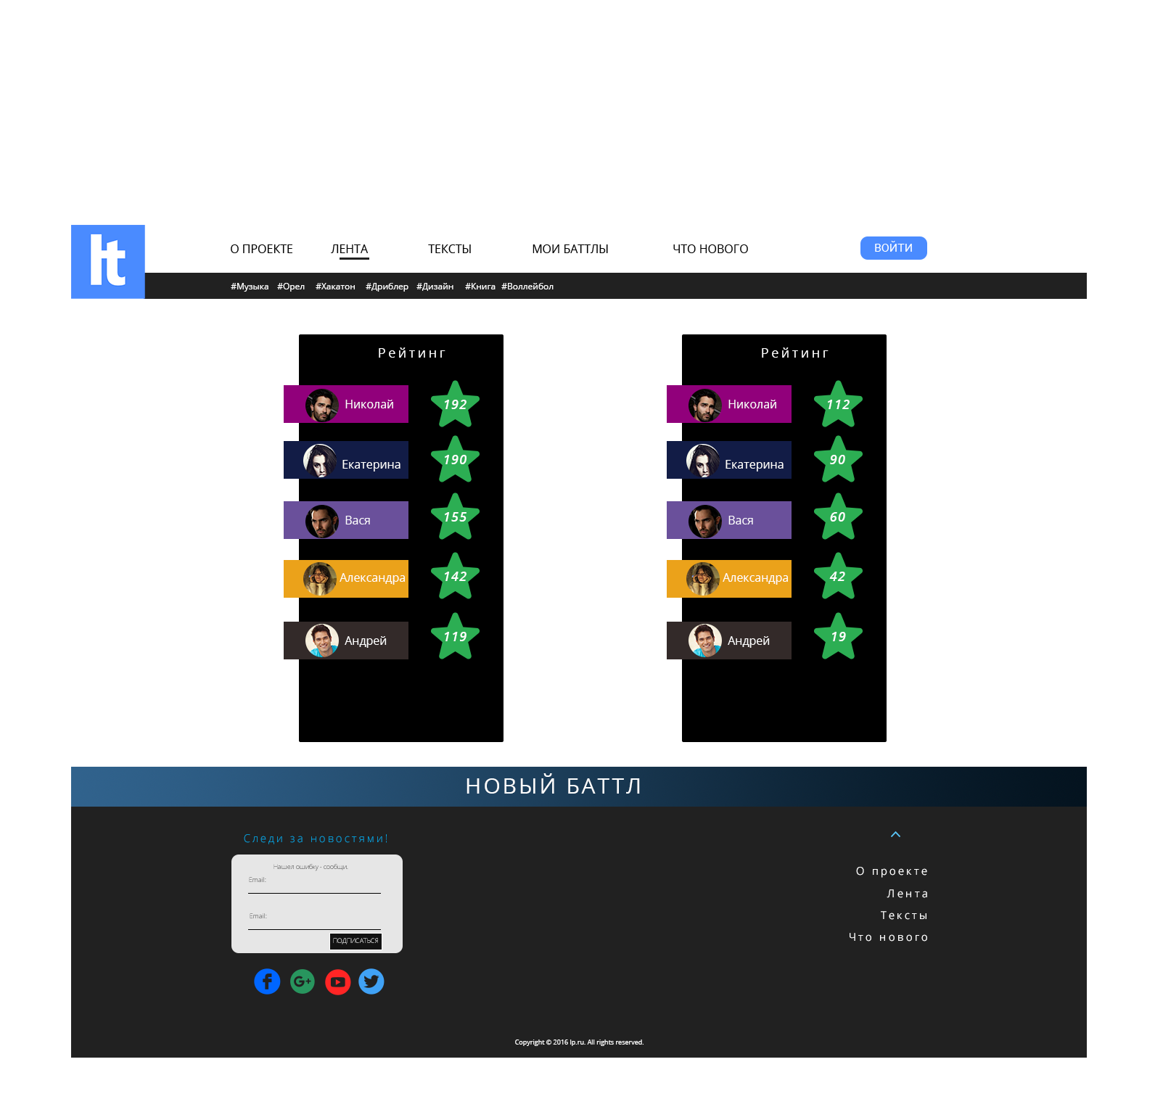

Slide 8

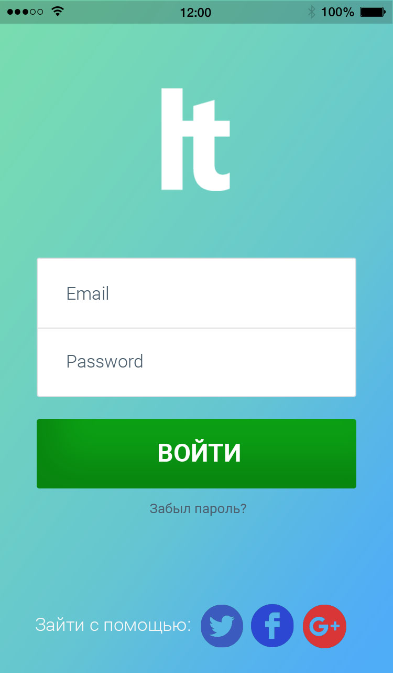

Slide 9
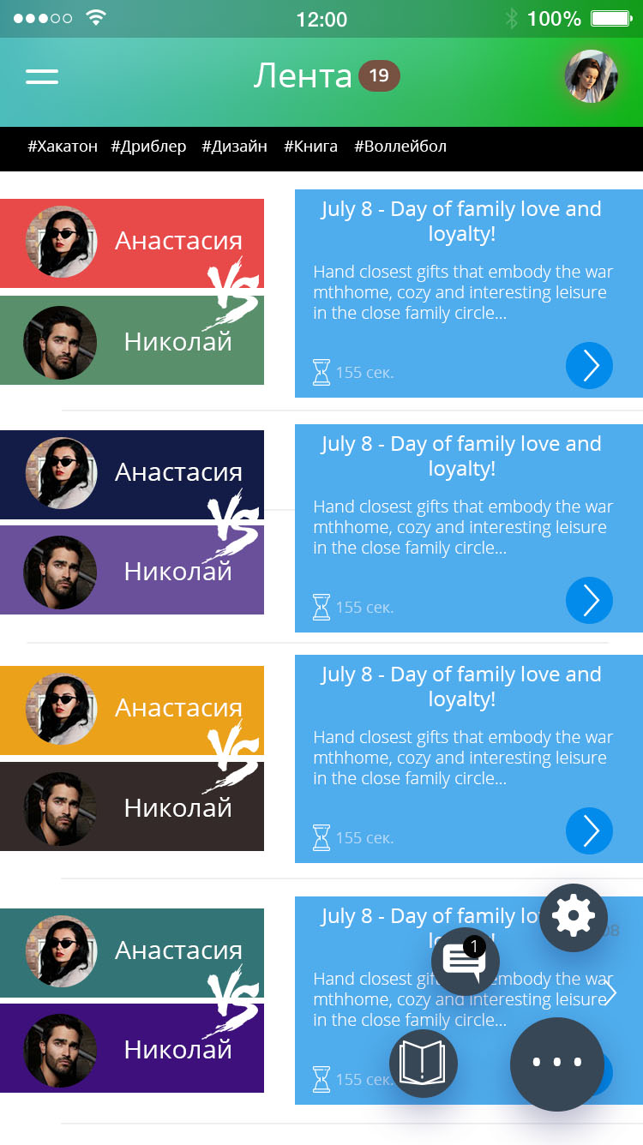
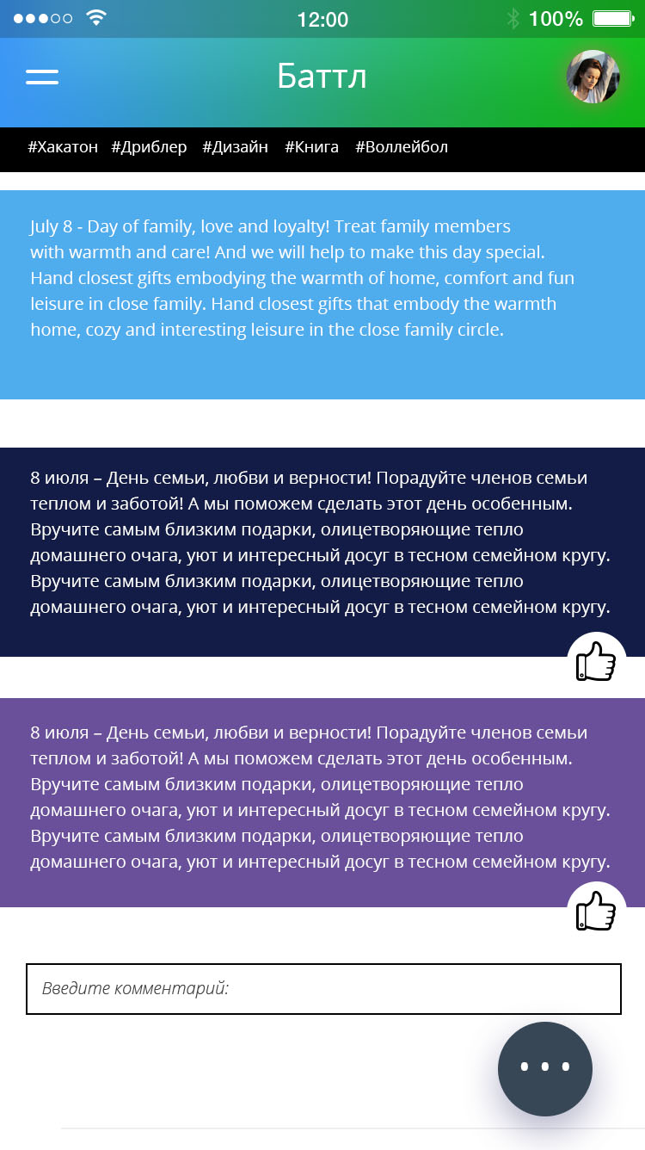

Slide 10



Gamefication
Experience
Skills
Achivments

Slide 11





Evolution
Evolution
Comics
Audio
Video(films)
Translation services
Education

Slide 12


Monetization
Close your content
Order to translate

Slide 13


Thanks for your attention
Volushkova Sasha
Project manager
Sobaka114
Balashov Andrey
Designer
mrbalashov
Shulenin Ilya
Backend developer
i-shulenin
Shkolenko Vitaliy
Frontend developer
vitaliy.shkolenko

